Slide 1
Lecture 2: How Computers Work
CSC111: Introduction to CS through Programming
Shinyoung Cho

Slide 2

Reminder
joined
discord?
changed
nickname?
discord.com/invite/JAfp7VF

Slide 3
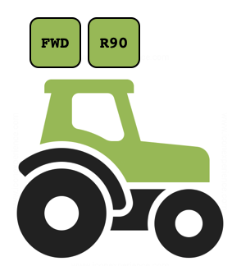
Overview
Last time
Goals / structure
Things computers can’t do
Activity: computational thinking
Crash course in computers
A little history
4 key components
Quick hardware demo
Boolean logic

Slide 4
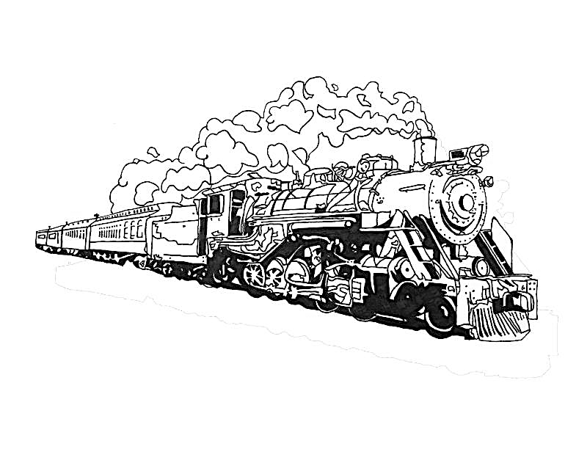
A little history…
This section based on examples from “What Makes a Computer, a Computer?” by May-Li Khoe and Nat Brown
Notes:
Humans are really good at building tools to help us do things that would otherwise be difficult. One day someone thought to themselves: “Golly, these rocks are heavy. If I have to move them one at a time, it’s going to take me all day…” Thoughts like this gave rise to wheelbarrows, hammers, steam engines, printing presses, and loads of other examples of machines designed to help make physical work easier.

Slide 5
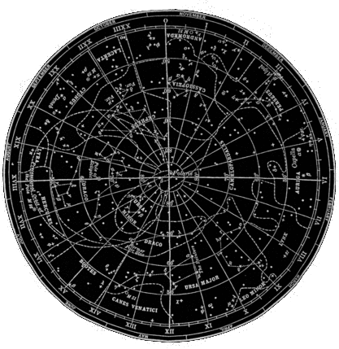
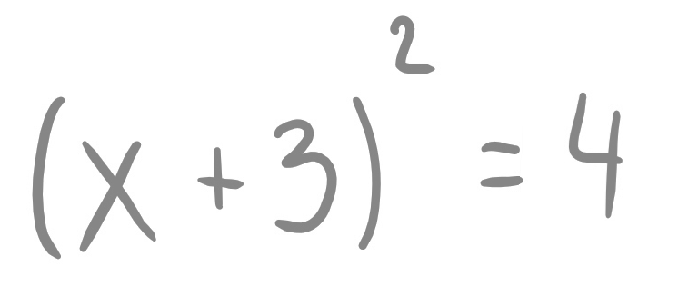
A little history…
This section based on examples from “What Makes a Computer, a Computer?” by May-Li Khoe and Nat Brown
Notes:
Eventually, people because to wonder about machines that could help make other kinds of work easier too. Things like solving equations or tracking the movement of stars in the sky. Rather than moving around physical stuff like dirt and rocks, these kinds of machines would need to be able to manipulate information.

Slide 6
A little history…
Notes:
As the early pioneers in computer science like Ada Lovelace and Charles Babbage started thinking about how they might go about designing a “thinking machine”, they realized that any such machine would need to be able to perform 4 basic tasks:

Slide 7


4 basic tasks
processing
input
output
storage
Notes:
Input, processing, storage, and output. So, they, the thinking machines, would need to be able to take in input, store that information, process it (and maybe store intermediate steps for later processing), and output the result.

Slide 8
Then and now
Early 19th century
Notes:
Those early computers were made out of wood and metal, and you literally turned a crank to make the “computation” happen. (The machine here, called Difference Engine, could do addition, subtraction, multiplication, division, and computation of polynomial)
Today’s computers look very different. They’re a lot smaller, a lot lightweight so portable, a lot faster, and a lot more powerful. But at their core, they still do those four basic things: take in input, store and process information, and output the result.

Slide 9
Input
processing
input
output
storage
Notes:
First let’s talk about input

Slide 10

Input
What are some ways that you
get information into a computer?
Notes:
Keyboard, mouse, touchscreen, camera, wearables: heartbeat, sensors in your car.

Slide 11
Input
processing
input
output
storage
Notes:
All these different kinds of input transmit information to the computer.

Slide 12
Storage
processing
input
output
storage
Notes:
which then gets stored in memory. Beside storing the input, the computer also need a way to save the intermediate/final results of data processing. For now, we’re going to ignore the specifics of how a computer’s memory works. Just think of it like a little warehouse: reasonably organized so it’s easy to find stuff, and big enough to store just about anything.

Slide 13
Processing
processing
input
output
storage
Notes:
Pieces of that stored information are pulled out by the central processing unit (CPU), the CPU can be seen as the brain of the computer, which manipulated or changes the information using an algorithm. An algorithm is just a sequence of commands, just like the ones you wrote yesterday for Tango the Tractor. Depending on the task, the intermediate results (for maybe more complex mathematical calculations) might get sent back to storage for later use.

Slide 14
Output
processing
input
output
storage
Notes:
Finally, when the calculation is complete, we’ll need some way to convert the results back into something a human can interpret.

Slide 15
Output
What are some ways that you
get information out of a computer?
Notes:
Screen (text, images, video, data visualization), VR, control a robot.
Speakers, headphones, 2D or 3D printers

Slide 16
Networks
Notes:
There’s another thing we could do with the output of a computational process: we could use is as input to another computational process… and another… and another… we can connect computers together to form massive networks. This is pretty powerful (and is, in a nutshell, how the internet works).

Slide 25
Then and now
Early 19th century
Notes:
Let’s move on to talk about Boolean logic. Before dive-in, let’s revisit the slide we talked about at the beginning of the class. Those early computers are mechanical devices and use different gears to represent information. Today’s computers are electronic devices that use electricity to represent information.

Slide 26
Discussion
How is information represented
using electricity?

Slide 27
One wire: a “bit”
“off”
“on”
Notes:
Let’s simplify things way down. Imagine our computer has just a single wire in it.
If we’re going to try to represent information by running electricity through this wire, we’ve got two possible states: either off and on.
That’s not a whole, … and lot to work with, but it’s enough to represent False and True, 0 and 1, No and Yes… or any other pair of values.
Because we[WE] can represent exactly two things, this is called a “binary” system. The on/off state of a single wire is called a ”bit”, and it’s the smallest piece of information a computer can store.

Slide 28
Multiple bits
1 bit:
2 bits:
3 bits:
4 bits:
OFF
ON
OFF
OFF
OFF
ON
ON
OFF
ON
ON
OFF
OFF
OFF
OFF
OFF
ON
OFF
ON
OFF
ON
OFF
OFF
OFF
ON
ON
ON
OFF
ON
ON
ON
OFF
ON
ON
ON
OFF
OFF
OFF
OFF
OFF
OFF
OFF
ON
OFF
OFF
ON
OFF
OFF
OFF
ON
ON
OFF
ON
OFF
OFF
OFF
ON
OFF
ON
OFF
ON
ON
OFF
OFF
ON
ON
ON
ON
OFF
OFF
OFF
ON
OFF
OFF
ON
ON
OFF
ON
OFF
ON
OFF
ON
ON
ON
ON
OFF
ON
ON
ON
OFF
OFF
ON
ON
ON
OFF
ON
ON
ON
ON
Notes:
As we add more bits, the amount of information we can store grows exponentially. For example, with two bits we can have 4 different states: off-off, off-on, on-off, and on-on. Again, with 3 bits, 4 bits, the amount of information we can store gorws exponentially. That’s kind of useful.

Slide 29
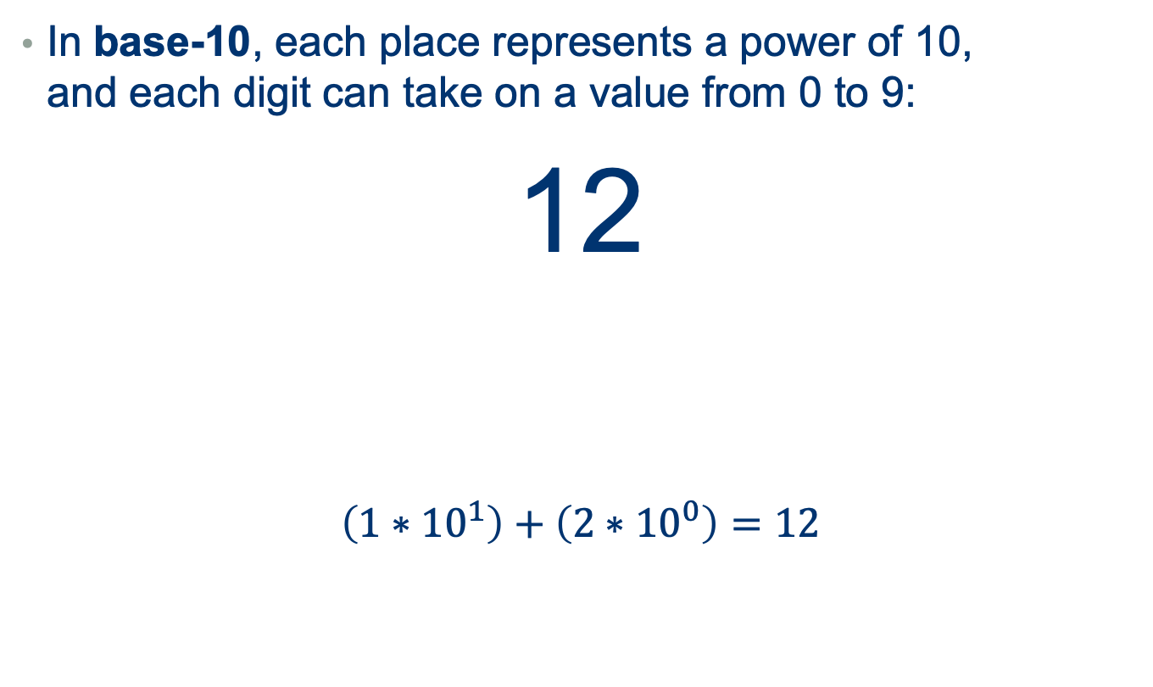
Using bits to represent numbers
In base-10, each place represents a power of 10, and each digit can take on a value from 0 to 9:
12
$$\left(1∗{10}^{1}\right)+\left(2∗{10}^{0}\right)=12$$
1 “ten”
2 “ones”

Slide 30
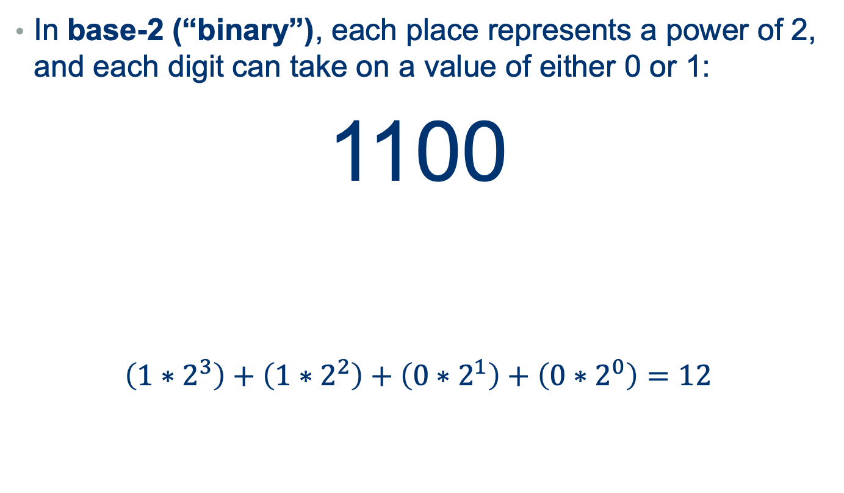
Using bits to represent numbers
In base-2 (“binary”), each place represents a power of 2, and each digit can take on a value of either 0 or 1:
1100
$$\left(1∗2^{3}\right)+\left(1∗2^{2}\right)+\left(0∗2^{1}\right)+\left(0∗2^{0}\right)=12$$
1 “eight”
0 “ones”
1 “four”
0 “twos”

Slide 31
How much can we represent?
With 8 bits*, we can represent the numbers 0 to 255 *8 bits is called a “byte”
With 32 bits, we can represent numbers > 4 billion
With 266 bits, we can represent more unique numbers than there are believed to be atoms in the universe

Slide 32
Binary images?
[0,1]

Slide 33
Greyscale images?
[0:255]

Slide 34
What about color?
([0:255], [0:255], [0:255])

Slide 35
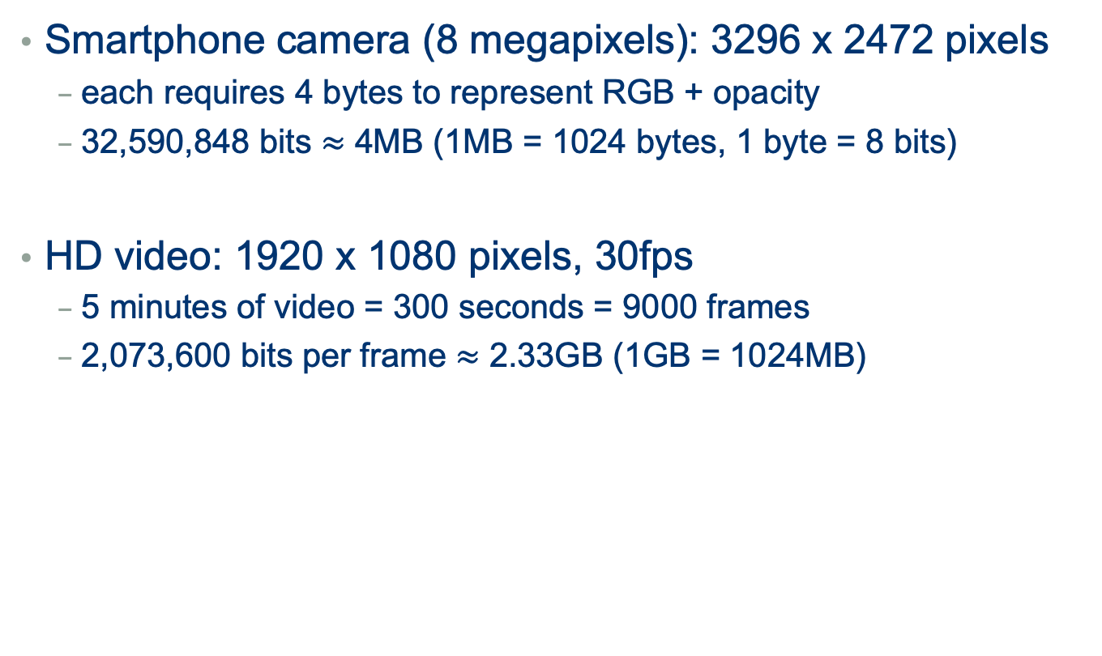
The tradeoff
Smartphone camera (8 megapixels): 3296 x 2472 pixels
each requires 4 bytes to represent RGB + opacity
32,590,848 bits $≈$ 4MB (1MB = 1024 bytes, 1 byte = 8 bits)
HD video: 1920 x 1080 pixels, 30fps
5 minutes of video = 300 seconds = 9000 frames
2,073,600 bits per frame $≈$ 2.33GB (1GB = 1024MB)

Slide 36
The good news
“High level” programming languages like Python mean we don’t have to write in “low level” binary
Instead, we write statements like:
print(“hello”)
Notes:
However, it’s useful to understand that for all the things we ask of our machines at a high level,
(x at this level (show hardware), everything we do is just operations on 0s and 1s.)

Slide 37
Overview of the next week
Crash course in computers
A little history
4 key components
Quick hardware demo
Boolean logic
Introduction to Python
Lab: Getting Started with Python
Variables and User Input
Numbers

Slide 38
Homework #1: how does it do that?

Slide 39
Homework #1: how does it do that?
Over the next few days: track your computation
(laptop, tablet, smartphone, ATM, distance tracker on the treadmill,…)
Pay attention to what you’re doing, and to what’s happening in response
Find one example where you don’t know how it works
In a ~1 page reflection:
describe what you were doing
describe the part you don’t really understand
give your best explanation for what you think is going on
Submit your PDF on Moodle by 11:55pm on Thursday

